Slide 1
MANAGEMENT 312:
Negotiation and Conflict Management Teams and Principal-Agent Relationships

Slide 2

Working in Teams
Negotiating as a team can have many positive effects
Added confidence
Increased information exchange
Improved outcomes

Slide 3

Working in Teams
Success is dependent on several factors
Size of the team
Bigger is not always better
Context matters
Communication
Trust
Information processing and sharing
Cohesion
Desire to be in group
Coordination of efforts

Slide 4

Working in Teams
In order to succeed, groups must become teams
A group of individuals placed together does not equal a team
Teams have
Shared goals
Shared strategies
Trust in team members to perform duties (accountability)
Do your job
The key to team success is preparation in two steps
Individual preparation
Essential to success
Team preparation
Prepare together!

Slide 5
Working in Teams
Team procedures
Determine, as a team, the team goals, issues, target, BATNA, etc.
What information can be shared? What can’t be shared?
What information does the team need to obtain?
What strategies do you want to employ?
Plan each team member’s role for the negotiation
Who is going to be the lead negotiator(s)?
Who is going to be the lead strategist(s)?
Who is going to be the accountant(s)?
Who is going to be the note taker(s)?
An individual may have more than one role in small teams

Slide 6
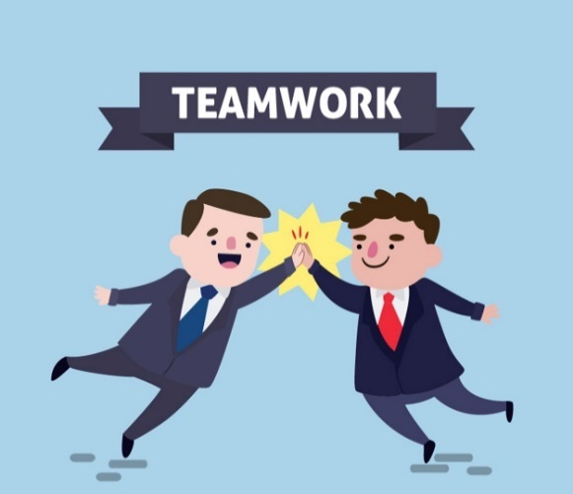
Working in Teams
Plan scheduled breaks from the negotiation table
Regroup
Share information
Some people may have information or signals
Evaluate and reset (if necessary) strategy
Do not allow your team to amplify fixed-pie or false conflict perceptions
A unified mindset and comprehensive strategy is key to success
However, encourage within-team questions

Slide 7
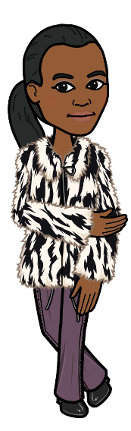

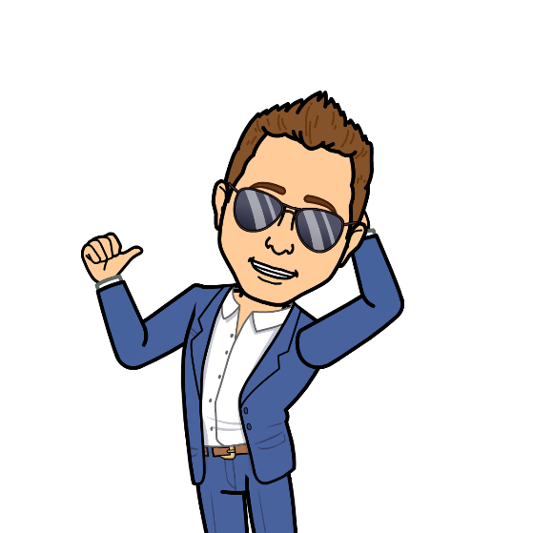

Principal-Agent Relationships

Slide 8
Principal-Agent Relationships
When a party has an agent represent them in negotiation
Agents typically receive a portion of the principal’s outcome
Agents can provide many benefits
Expertise
Emotional detachment
Networks
Ratification opportunities (limited decision making power)
But also some negatives
Reduced bargaining zone
Risk of misaligned incentives
Communication errors
Loss of control

Slide 9
Principal-Agent Relationships
Keys to successfully working with an agent
Find the right agent (do your research)
Know as much information as possible
Try to know as much as your agent
Know your BATNA before meeting your agent
Use your agent to your benefit (remember they work for you)
Ratification
Buffer
Agent’s expertise
Communicate!

Slide 10

Summary
With more people comes more complications
Teams and principal-agent relationships change the dynamic of negotiation
Key to success is planning and clear communication
Clearly communicating with team members, planning for the negotiation, and continued cooperation will lead to success
The importance of planning and strategy development is amplified

